Slide 1





Writing a Resume
Good Practices and Strategies, Examples
Doncho Minkov
Technical Trainer
www.minkov.it
Telerik Academy
academy.telerik.com

Slide 2


Table of Contents
What Is a Resume?
Why We Need of a Resume?
Why We Need a Good Resume?
The Goal
Success strategy
How to Stand Out?
Structure
Questions

Slide 3

What Is a Resume?

Slide 4


What Is a Resume?
Summary of skills and experience
Notes:
A summary of your experiences and skills
Relevant to the application
Highlights your accomplishments
Show an employer that you are qualified for a particular job position
Not a biography of everything you have done
Should reflect more than just your paid work experience
Current students, in particular, should consider including the details of your more important extracurricular, volunteer and leadership experiences.
Tailor separate resumes to fit each career field in which you are job searching. Some people create slightly different resumes tailored to each job opening.

Slide 5

What Is a Resume?
Summary of skills and experience
Not a biography
Notes:
A summary of your experiences and skills
Relevant to the application
Highlights your accomplishments
Show an employer that you are qualified for a particular job position
Not a biography of everything you have done
Should reflect more than just your paid work experience
Current students, in particular, should consider including the details of your more important extracurricular, volunteer and leadership experiences.
Tailor separate resumes to fit each career field in which you are job searching. Some people create slightly different resumes tailored to each job opening.

Slide 6

What Is a Resume?
Summary of skills and experience
Not a biography
Highlights accomplishments
Notes:
A summary of your experiences and skills
Relevant to the application
Highlights your accomplishments
Show an employer that you are qualified for a particular job position
Not a biography of everything you have done
Should reflect more than just your paid work experience
Current students, in particular, should consider including the details of your more important extracurricular, volunteer and leadership experiences.
Tailor separate resumes to fit each career field in which you are job searching. Some people create slightly different resumes tailored to each job opening.

Slide 7

Why We Need of a Resume?
Show experience

Slide 8

Why We Need of a Resume?
Show experience
Reflects more than paid work experience

Slide 9

Why We Need of a Resume?
Show experience
Reflects more than paid work experience
Why we are better than the rest

Slide 10

Why We Need of a Resume?
Show our skills and abilities
Show experience
Reflects more than paid work experience
Why we are better than the rest

Slide 11

Why We Need a Good Resume?

Slide 12

Why We Need a Good Resume?
Because of the Recruiters!

Slide 13

Why We Need a Good Resume?
Because of the Recruiters!
No time to fully review every CV

Slide 14

Recruiters

Slide 15



Recruiters:
Review 100 CVs

Slide 16


Recruiters:
Review 100 CVs
Select only 1 for interview

Slide 17


Recruiters spend 20-60 seconds on a Resume

Slide 18


The first impression
The recruiters count most:
Finding the correct keywords

Slide 19

The Goal

Slide 20

Sell
The Goal

Slide 21

Sell
The Goal
Inform

Slide 22

Sell
The Goal
Persuade
Inform

Slide 23


Sell
The Goal
Persuade
Inform
Get an Interview!

Slide 24



OK. But how to do all this?

Slide 25

OK. But how to do all this?
All you need is a!

Slide 26

The Success Strategy?

Slide 27
The Success Strategy?
Be unique

Slide 28
The Success Strategy?
What you want next?
Be unique

Slide 29
The Success Strategy?
The point of the Resume
What you want next?
Be unique

Slide 30
The Success Strategy?
What the employer wants?
The point of the Resume
What you want next?
Be unique

Slide 31
The Success Strategy?
Good presentation
What the employer wants?
The point of the Resume
What you want next?
Be unique

Slide 32
The Success Strategy?
Good presentation
What the employer wants?
The point of the Resume
What you want next?
Be unique
Success Strategy

Slide 33
Be Unique
Good presentation
What the employer wants?
The point of the Resume
What you want next?
Be unique
Success Strategy

Slide 34

Be Unique
Good presentation
Don't copy paste
What the employer wants?
The point of the Resume
What you want next?
Be unique
Success Strategy

Slide 35

Be Unique
Good presentation
Don't copy paste
What the employer wants?
The point of the Resume
What you want next?
Be unique
Success Strategy
Show creativeness

Slide 36

Be Unique
Good presentation
Don't copy paste
What the employer wants?
The point of the Resume
What you want next?
Be unique
Success Strategy
Show creativeness
Show what you want to show

Slide 37
What You Want Next?
Good presentation
What the employer wants?
The point of the Resume
What you want next?
Be unique
Success Strategy

Slide 38

What You Want Next?
Good presentation
What the employer wants?
The point of the Resume
What you want next?
Be unique
Success Strategy
Why you choose this exact job offer?

Slide 39


What You Want Next?
Good presentation
What the employer wants?
The point of the Resume
What you want next?
Be unique
Success Strategy
Why you choose this exact job offer?
How you plan to develop yourself in the future?

Slide 40
The Point of The Resume
Good presentation
What the employer wants?
The point of the Resume
What you want next?
Be unique
Success Strategy
Who will read it?
What is the position you are applying for?
Why are you writing it?

Slide 41
What the Employer Wants?
Good presentation
What the employer wants?
The point of the Resume
What you want next?
Be unique
Success Strategy
Highlight the relevant things
Show what the employer wants to see
Or just what you have been paid for
Not all you have done

Slide 42



Good Presentation
Be consistent
Good presentation
What the employer wants?
The point of the Resume
What you want next
Be unique
Success Strategy
Be brief
Be Focused

Slide 43

How to Stand Out?
Make your Resume remarkable

Slide 44

How to Stand Out?
Chance of fail first time

Slide 45
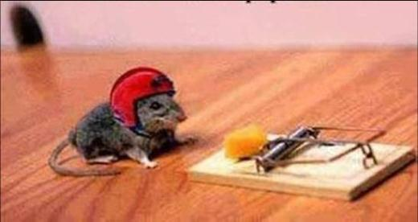
How to Stand Out?
Chance of fail first time
Take risks

Slide 46
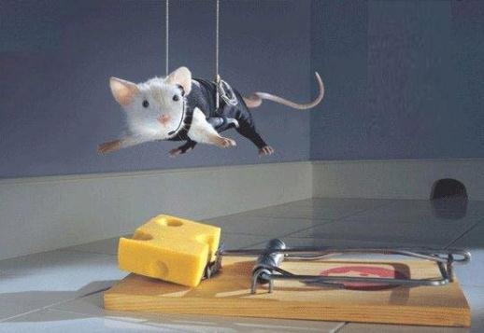
How to Stand Out?
Chance of fail first time
Take risks
Use "Trial and Error" methodology

Slide 47

Structure Your Resume
There are some must-have sections in your CV
Personal information
Objective
Previous work experience
Education
Projects developed
E.g. at the university, high school or in free time
Skills and abilities
Other experience
E.g. at the university
Resume

Slide 48
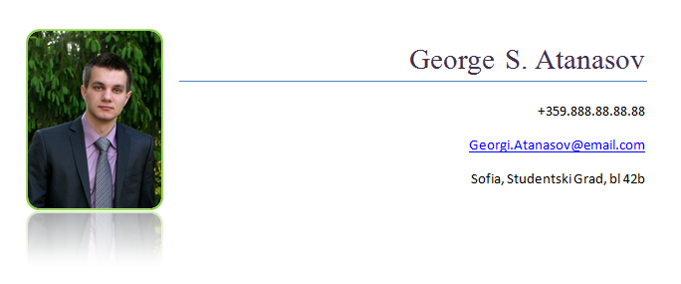
Personal Information
Always put it in the top
Include the following
Your name
A photo
Your contacts
Email address
Telephone number
Home address
Personal Info

Slide 49

The Photo
Use a professional photo
Photo

Slide 50

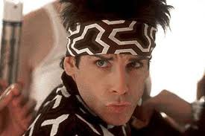
Use a professional photo
The Photo
Don't use Facebook photos!
Better no photo at all

Slide 51


The Contacts
Use your personal contacts
Personal email, personal telephone!
Never use work contacts
Be sure to have a good-looking email address
Even if you use it only for job applications
PeterPetrov@, Peter.Petrov@, Asen_Georgiev@
Not emails like:
DestructorMachine@, Svalyacha92@, P373rP37r0v@

Slide 52

Objective
The objective should be after the personal information
What you are applying for?
Be descriptive, but be brief
Don't be overdescriptive
Objective

Slide 53

Previous Work Experience
Write your previous work experience
Best to order them by date
Explain your duties at this position
Don't be overdescriptive about your managers
Better not to include full names and contacts
Experience

Slide 54

Education
Write down all the schools you have gone to
University
High school
It is always better to highlight courses you visited and are relevant to the job offer
Add relevant informal education
E.g. @ Telerik Academy
Education

Slide 55

Projects Developed
The best way to show expertise is to show something real
Like projects you have developed
This gives a better impression than just plain words like "I am good at…"
No projects?
Why not start a project, to gain experience?
Projects

Slide 56
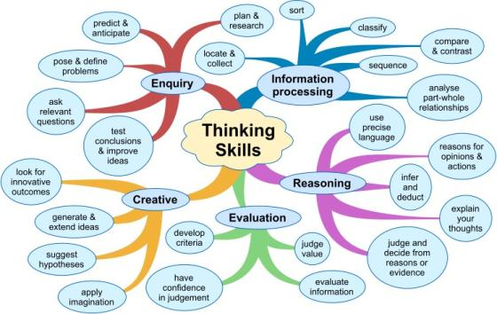
Skills and Abilities
Write down all your skills and abilities
All of them are important
But some are more important than others
Highlight the skills that are most relevant to the current job description
Just mention the others
Skills

Slide 57

Other Experience
If you have any other experience that is relevant to the job offer – show it!
Experience

Slide 58
Homework
Following our guidelines write your resume
Target it to your preferred job position and employer
If you don't have work experience think how you could change this
If you don't have any projects, start a project (e.g. open-source in GitHub or Google Code)
E.g. create your own web site
Find people who can write endorsements for you

Slide 59
Summary of Your Resume
There are some must-have sections in your CV
Personal information
Objective
Previous work experience
Education
Projects developed
E.g. at the university, high school or in free time
Skills and abilities
Other experience
E.g. at the university
Resume

Slide 60
Writing a Resume
?
?
?
?
?
Questions?
?
?
?
?
?
?

Slide 61

Thank You!

